Slide 1
Presented by: Amal Abdirahman Date: 30th April 2026
CAPSTONE PROJECT

Slide 2
Project Overview & Objectives
Goal: To analyze procurement datasets and build predictive models to determine the "Status" of procurement activities.
Key Tasks:
Exploratory Data Analysis (EDA) of PPDA datasets.
Data cleaning and preprocessing for Machine Learning.
Comparison of Classical ML (Random Forest) vs. Neural Networks (MLP).
Deployment of an interactive demo for real-time predictions.

Slide 3
Data Loading & Initial Exploration
Step: Importing Libraries and Dataset.
Libraries Used: Pandas (Data handling), Matplotlib (Visualization), Scikit-Learn (Modeling).
The Dataset: Sourced from: Dataset_Final_Project from PPDA.xlsx.
Core features: Procurement Method, Contract Value, Number of Bids, Region, and Procuring Entity.

Slide 4
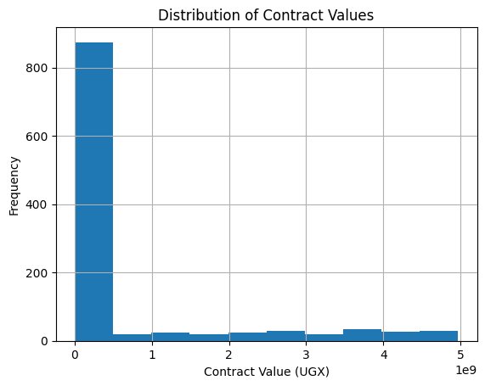
Data Visualization (Univariate Analysis)
This histogram shows that most contracts are concentrated at very low monetary values, with the frequency dropping sharply as contract amounts increase. In other words, the distribution is highly right-skewed: the majority of contracts are small, while only a few reach into the millions or billions of Ugandan Shillings. This pattern highlights an imbalance where everyday transactions dominate in number, but a small set of very large contracts carry disproportionate financial weight, making them especially significant for risk management and overall economic impact.

Slide 5
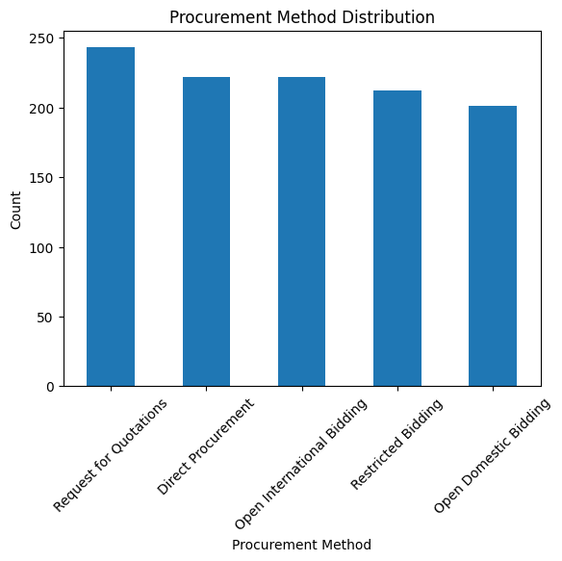
Cont…
This bar chart compares the frequency of different procurement methods, showing that Request for Quotations is the most commonly used, followed closely by Direct Procurement and Open International Bidding, while Restricted Bidding and Open Domestic Bidding are slightly less frequent. Overall, the distribution is fairly balanced across the five categories, but the slight lead of Request for Quotations suggests that organizations often prefer simpler, faster methods of procurement. This illustrates how procurement practices are spread across various approaches, with no single method overwhelmingly dominant, but with a clear tendency toward quotation-based requests.

Slide 6
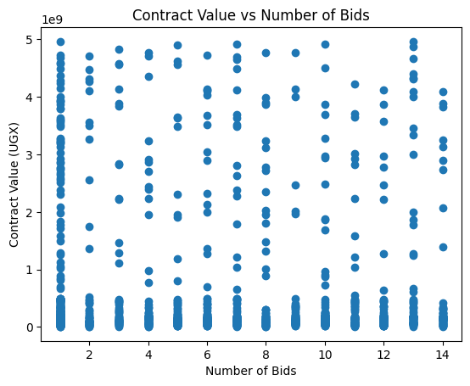
Data Visualization (Multivariate Analysis)
This scatter plot shows how contract value relates to the number of bids. The points are spread out, meaning contracts of all sizes can get either few or many bids. Some very large contracts only attract a small number of bidders, while smaller contracts appear across different bid counts. In simple terms, there isn’t a clear link between contract size and how many bids it receives—other factors likely influence bidder participation.

Slide 7
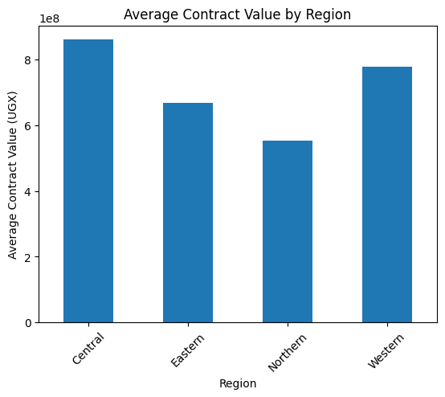
Cont…
This bar chart compares the average contract values across regions. The Central region stands out with the highest average, followed by Western, then Eastern, while Northern has the lowest. In simple terms, contracts in the Central region tend to be worth more money than those in other regions, showing clear regional differences in procurement amounts.

Slide 8
Data Cleaning & Preparation
Encoding: Converting text data (Categories, Regions, Methods) into numerical format using LabelEncoder.
Feature Selection: * Target: Status (What we want to predict).
Excluded: Contract_ID (Unique identifiers that don't help prediction).
Feature Scaling: Using StandardScaler to ensure all numerical inputs (like large contract values) are on the same scale for the Neural Network.

Slide 9

Model Training & Comparison
Dataset Split: 80% Training / 20% Testing.
Model 1: Random Forest (Classical ML)
An ensemble of decision trees.
Robust against noise and effective for categorical data.
Model 2: MLPClassifier (Neural Network)
A multi-layer perceptron capable of learning complex, non-linear patterns.

Slide 10
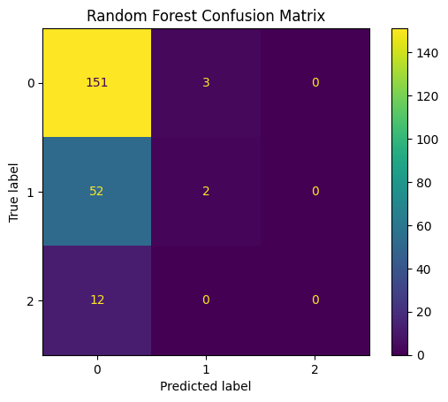
Performance Evaluation
This confusion matrix shows how well the Random Forest model classified three categories (0, 1, and 2). Most of the predictions are correct for class 0, with 151 contracts correctly identified, but there are some mistakes: 52 items that should be class 1 and 12 that should be class 2 were wrongly predicted as class 0. Very few items were predicted as class 1, and none were predicted as class 2. In simple terms, the model is very good at spotting class 0 but struggles to recognize classes 1 and 2, often misclassifying them as 0. This means the model is **imbalanced**, performing strongly for one class while weak for the others.

Slide 11
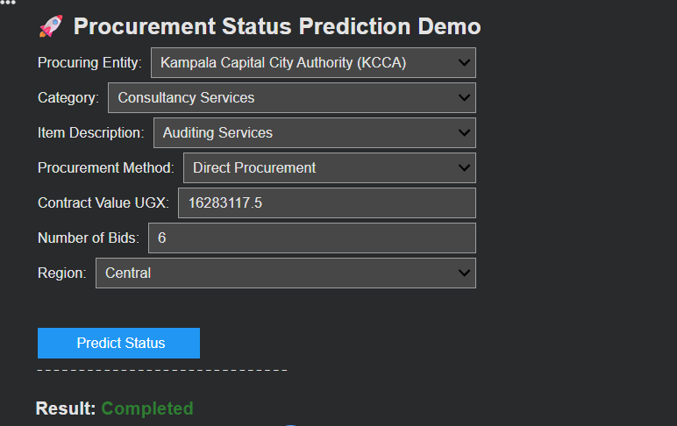
Interactive Demo (Implementation)
The Interface: Built using ipywidgets.
Functionality:
Users can select a Region, Category, and Method from dropdowns.
Users enter a Contract Value and Bid count.
Result: The model provides a real-time prediction (e.g., "Awarded") with a confidence percentage.

Slide 12
Conclusion & Future Scope
Summary: Successfully built a pipeline from raw data to a working predictive tool.
Findings: Mention which model performed better (Random Forest vs. Neural Network).
Future Improvements: * Integrating more historical data.
Deploying the model as a web application.
Automating data cleaning for new entries.

